Slide 1
Risk Pricing and Competitive Strategy in Auto Insurance
Vincent Piper

Slide 2
Goal
The goal of this project is to compare optimal pricing strategies of Progressive, State Farm, Geico and Allstate as competitors through various measures produced on their 2022-2023 annual financial statements
The project will display baseline scenarios for various standards of measure from all four companies and analyze statistically significant or outlying resulting data points
This project requires a strong knowledge of probability theory and game theory concepts, as well as an intuitive understanding of insurance, financial statements and competitive pricing

Slide 3
Standards for measure
To gain the best insight into each company’s background, reported annual financial statements were analyzed thoroughly for 11 different measures
Premiums earned Claims Incurred Expense Ratio Underwriting profit/loss
Premiums written Loss Ratio Combined Ratio Avg Premium per Policy
Investment Incomes Policies in Force Reserves for Claims
Each of these 11 measures plays a key part in understanding the past, present and future stability/volatility of each company.
Values not explicitly available in financial reports were approximated using probabilistic models, incorporating trend analysis and industry benchmarks from competitor data to ensure a reliable estimation

Slide 4
Lognormal Estimated Number of Claims and Claim Frequency
As the number of annual claims filed for each company is not public information, rough evaluations of this metric were made on a lognormal distribution with parameters of shape (σ), location (floc=0) and scale (μ)
This distribution estimated the number of claims using a range of claim severities from 3000 to 10000 along with the number of annual policies in force for each company
Claim frequency was then calculated by dividing the number of claims by the amount of policies in force.

Slide 5
Baseline Scenarios

Slide 6
Underwriting Profits Baseline Scenario
- The first sensitivity analysis focuses on underwriting profit, a critical indicator of a company's financial health and ability to manage risk effectively.
- A company with a strong underwriting profit can afford to take on more risk, reinvest in the business, reward long-term stakeholders, and maintain a cushion for future claims.
- In this baseline scenario, we will use key metrics related to underwriting profit to assess a company’s financial stability and its capacity to manage resources efficiently while planning for future growth.

Slide 7
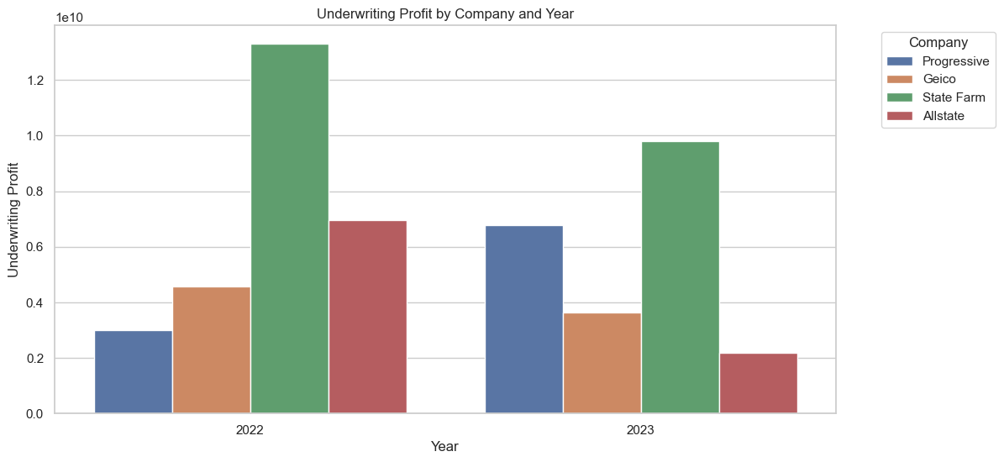

Slide 8
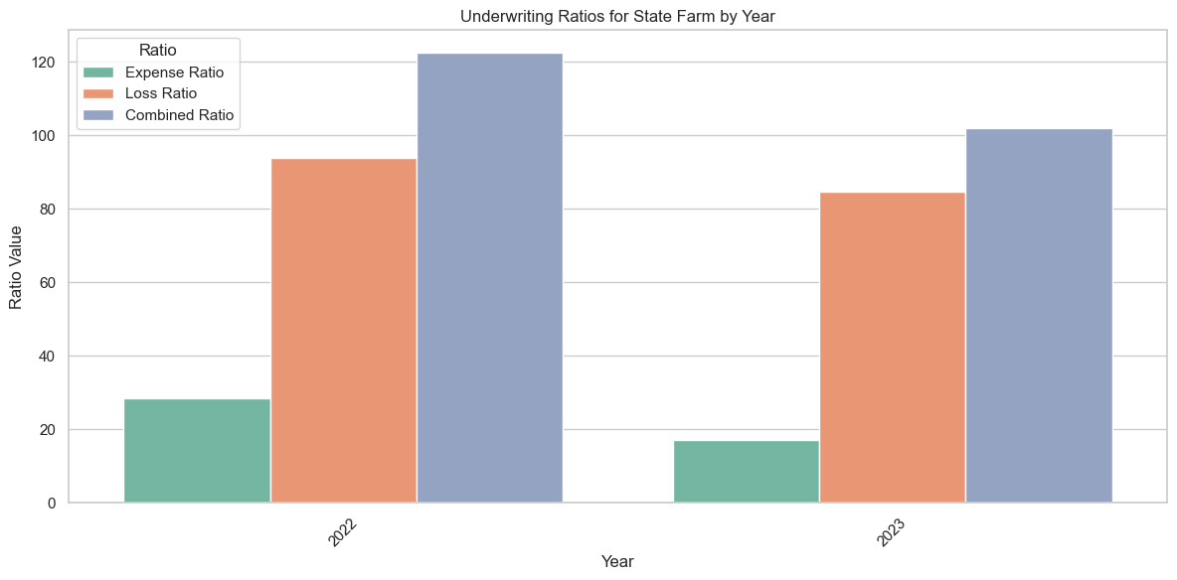
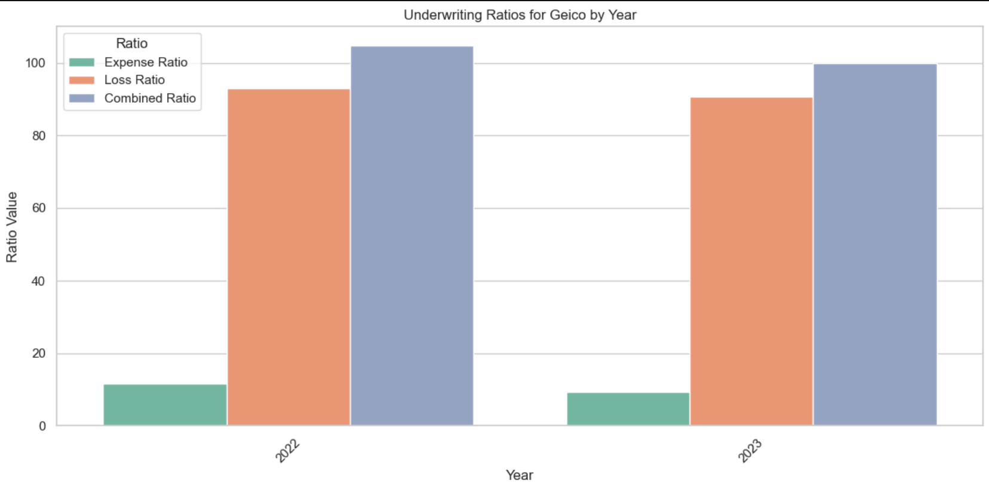

Slide 9
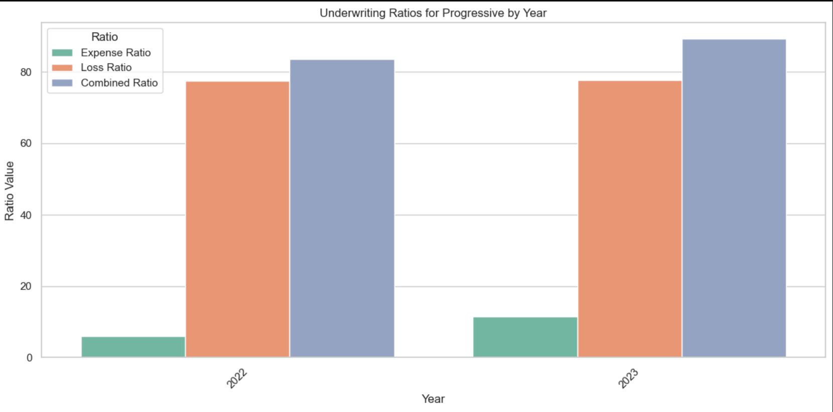


Slide 10
Results
- The first reason for why Progressive's underwriting succeeds and Allstate, Geico and State Farm's underwriting falls behind stems from the Loss and Expense Ratios
- Progressive has had a significant increase in its expense ratio which, when countered with its low loss ratio, still leaves the combined ratio at a much better standing than the competition's
- Despite expected relatively high loss ratios for each company, as well as State Farm and Geico even decreasing their loss ratio from the previous year, Progressive has been the sole company of these giants to produce a positive percent increase in expense ratio whilst keeping the ratio itself to under 100, hence leading to underwriting profits

Slide 11
Investment Income Baseline Scenario
- Next we will analyze investment income, a strong indicator of how well each company is managing their assets and how successful they are at gaining a profit from successful investments.
- This income is used to provide shareholders better returns and/or higher dividends, as well as for reinvestment back into the company to offset underwriting losses
- Companies can also use values derived from underwriting profits and investment income as a baseline for determining an optimal business strategy:
* lower premiums with the intended outcome of average customer retention and prioritizing high investment income
* higher premiums with the intended outcome of prioritized high customer retention and lower investment income

Slide 12
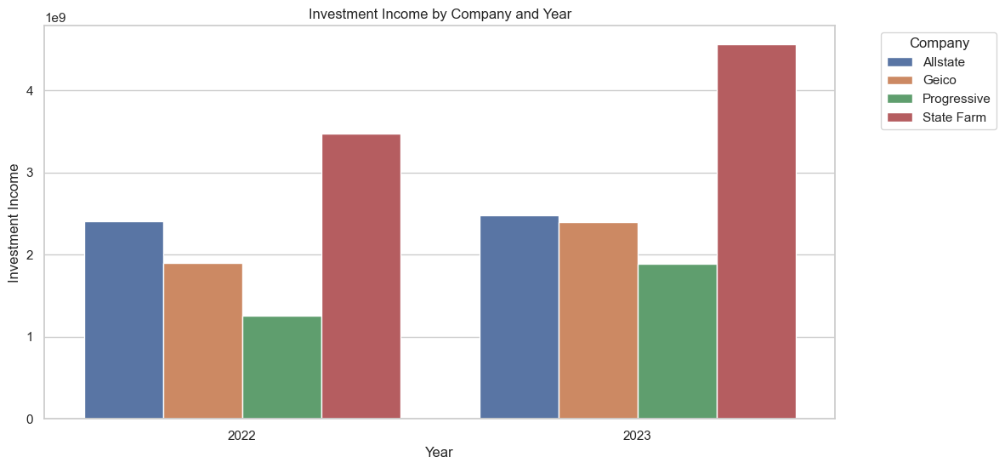

Slide 13
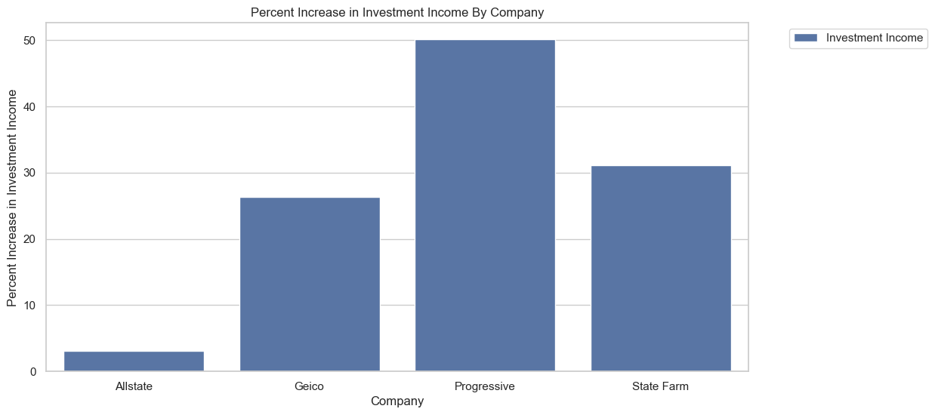

Slide 14
Results
* While Progressive has also shown success in the underwriting sector, their investment income pales in comparison to State Farm's
* This is due to State Farm's mututal company structure; State Farm is owned by policyholders rather than shareholders, which allows them to create a more diversified and patient portfolio with profitable long term investments.
* However, when looking at percent increases for each company, Progressive has shown the most increase in the past year of investment income: a tribute to their very successful marketing and financial management

Slide 15
Policies In Force Baseline Scenario
- PIF is a key indicator of market share, and a company with a large number of policies has greater market leverage
- If a company has a strong market share, it may have more pricing flexibility to offer competitive premiums while still maintaining profitability
- More PIF would also indicate that a company is succeeding in marketing and advertising their products.

Slide 16
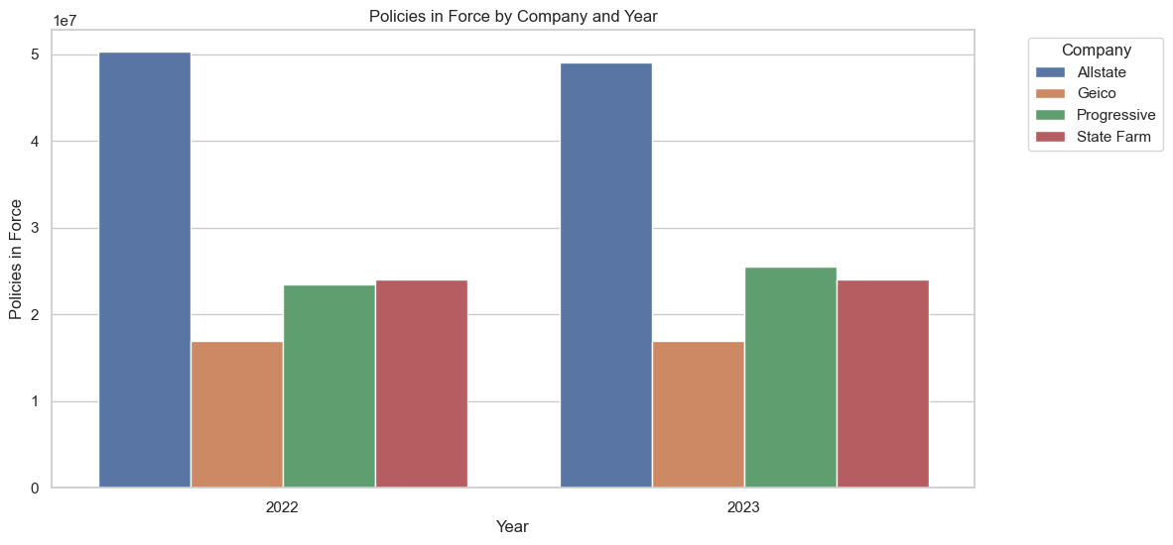

Slide 17
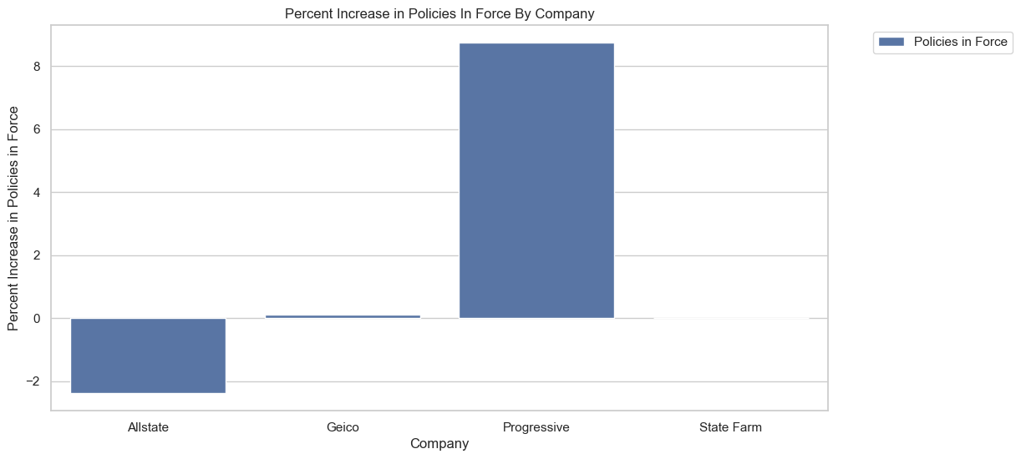

Slide 18
Results
- Progressive dominates the field of policies in force and, when given the data above, this seems rather shocking, considering that the claims incurred by Progressive is relatively similar to that of Geico and State Farm and the increase in claims incurred, if anything, should only hinder Progressive in this field
- Progressive's underwriting profits have certainly benefited them in this regard as they seem to reinvest this money into profitable marketing schemes which combat consumer attrition
- Although this is not represented in the data above, the aforementioned conclusion can be inferred due to the stark contrast in percent increase between Progressive and its competitors

Slide 19
Reserves for Claims Baseline Scenario
- Reserves for claims function as a financial safety net, ensuring that an insurer can meet its obligations to policyholders without overly relying on fluctuating underwriting profits
- By maintaining healthy reserves, a company is better equipped to absorb shocks from unexpected losses and smooth out financial volatility
- A high quantity of reserves can also give flexibility to a company that is looking to keep their premiums competitive and take more financial risk

Slide 20
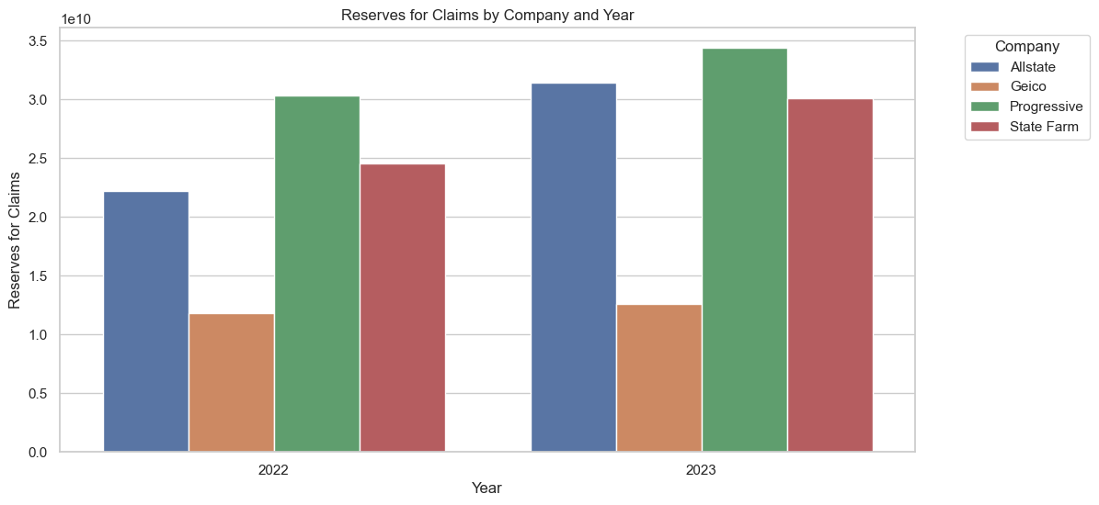

Slide 21
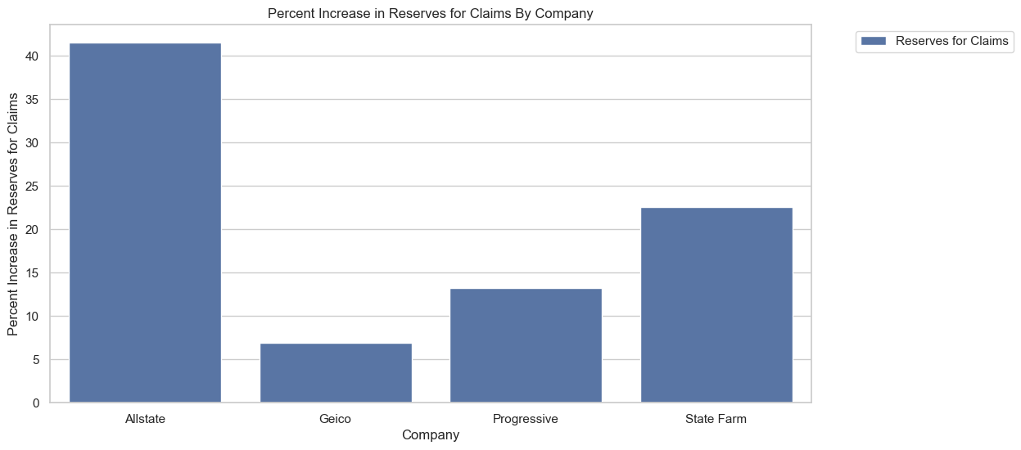

Slide 22
Results
- Claims reserves are an essential indicator of a company's expectations of the value of future premiums
- Allstate has increased their claims reserves by more than 40%, signaling preparation for a large increase in amount of claims in the next coming year; this foresight is most likely the cause of their drop in underwriting profits as well as State Farm's.
- State Farm, Progressive and Geico have kept their reserves moderate; they are most likely content with their business strategies and their premium price.

